Slide 1
Tourist route in the Shatkovsky district “Memory. The culture. Health". AVRORA

Slide 2
Description of the route.
The name of the route: Memory. The culture. Health.
Target audience Travel will be interesting for both children and adults.
Season: Summer
Duration of the tour 2 days
How to get there By bus
Points that the First Day route passes through:
1. The village of Sharapovo is a local history museum.
2. The village of Old Ivantsevo - a museum of Mordovian culture.
3. The village of Ponetaevka - the architectural complex of the Seraphim-Ponetaevsky monastery.
Second day:
4. The village of Hirino - Church of St. John the Baptist.
5. The working village of Shatki:
- The memorial complex "Dedicated to Tanya Savicheva and the Children of War."
- The grave of Tanya Savicheva
6. The village of Arkhangelsk - source "Boiling Key"

Slide 3
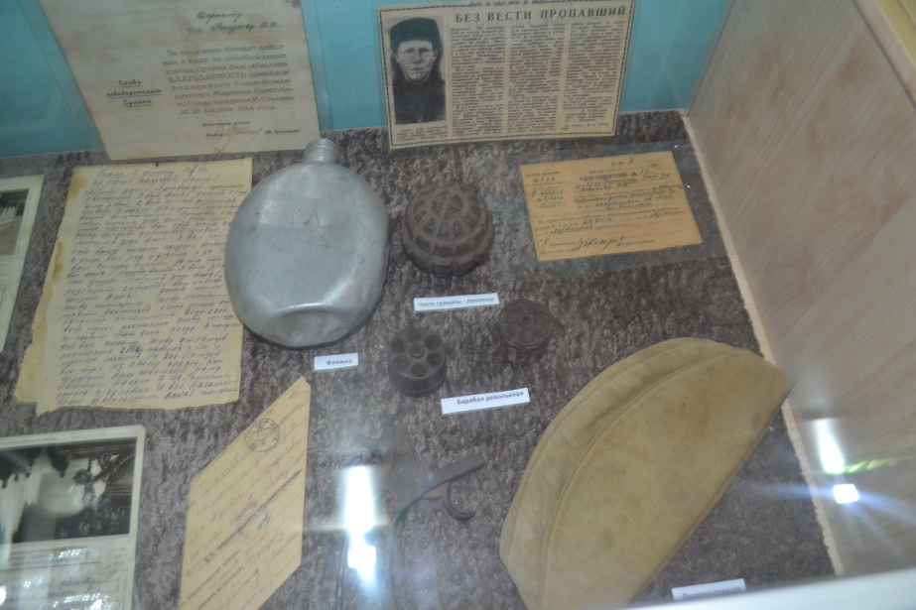
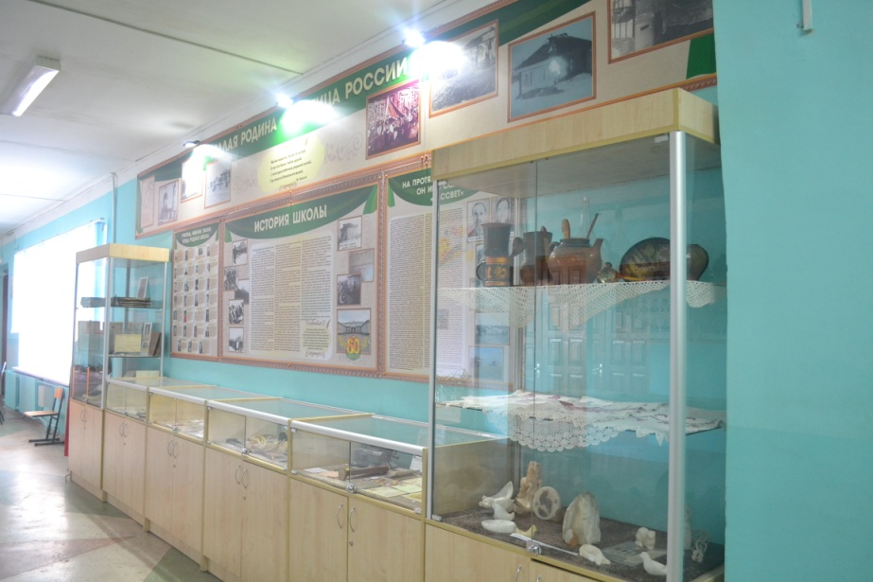
Local History Museum of the village of Sharapovo
The museum of local lore of our village was founded in the second half of the 20th century by the director of a local school Vasily Petrovich Agafonov. At first, the museum was located in the school building. Then, when the school was suffered by fire it was transferred to the administration building. After the opening of the new school the museum returned to the educational institution. There you can see the tools of ancient people, household items of the 17-18 centuries, the history of the collective farm and school, photographs of famous people from the village of Sharapovo.

Slide 4
Staroivantsev Museum of Mordovian culture
The museum is dedicated to the history of the village of Old Ivantsevo, the material and spiritual culture of the Mordva-Erzya people. So, in the exposition “Mordovian Culture and Life” household items, agricultural implements, implements and handicrafts and crafts, Mordovian clothes are presented.
The exposition “The history of the village of Old Ivantsevo” introduces the history of the ancient village of Shatkovsky district. Here you can see old women's jewelry: bronze rings, earrings, pendants. All these items were recovered from a burial site discovered in 1960 in the village. The museum also features Tripoli culture, which existed five thousand years ago.
Among the rare exhibits of the museum there are many genuine documents: photographs, pre-revolutionary textbooks, magazines, albums. Materials are presented about the events that took place in the village at the end of the 19th century - the beginning of the 20th century, about the stay in the village of A.P. Gaidar, about the participants of the Great Patriotic War, the history of the Old-Ivantsevskaya school.

Slide 5
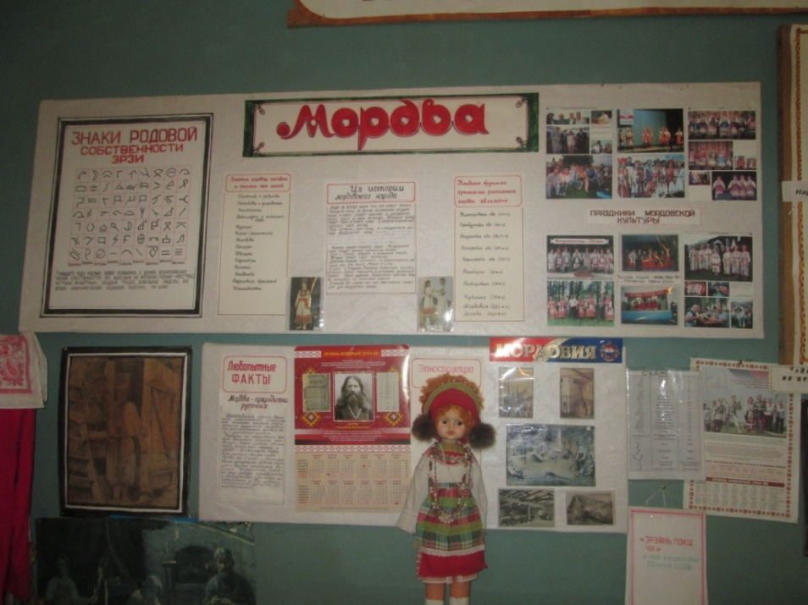
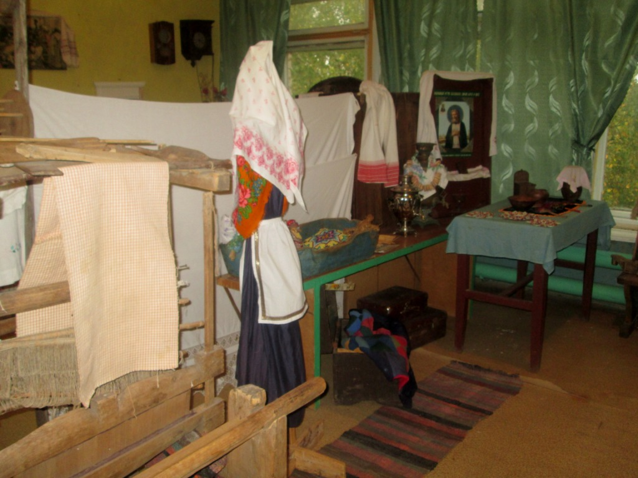
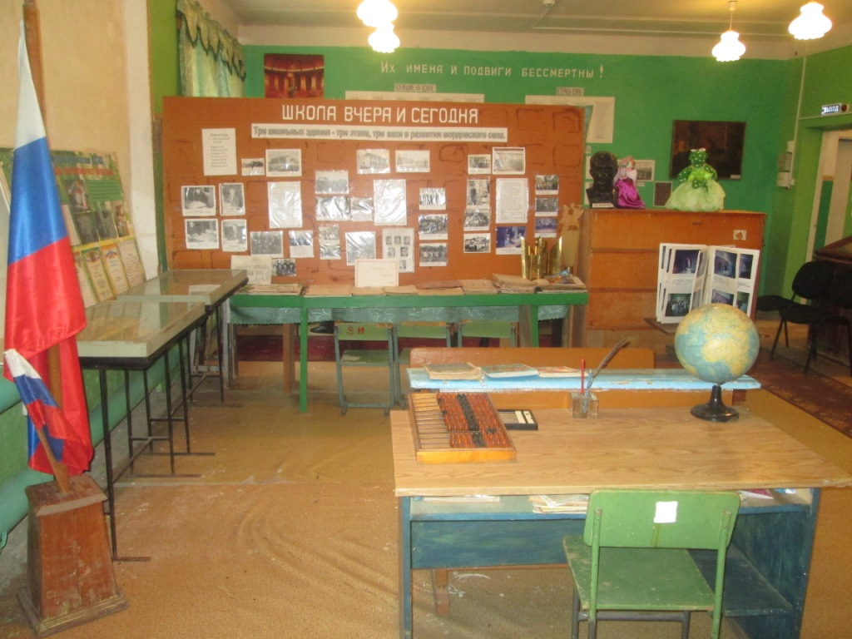
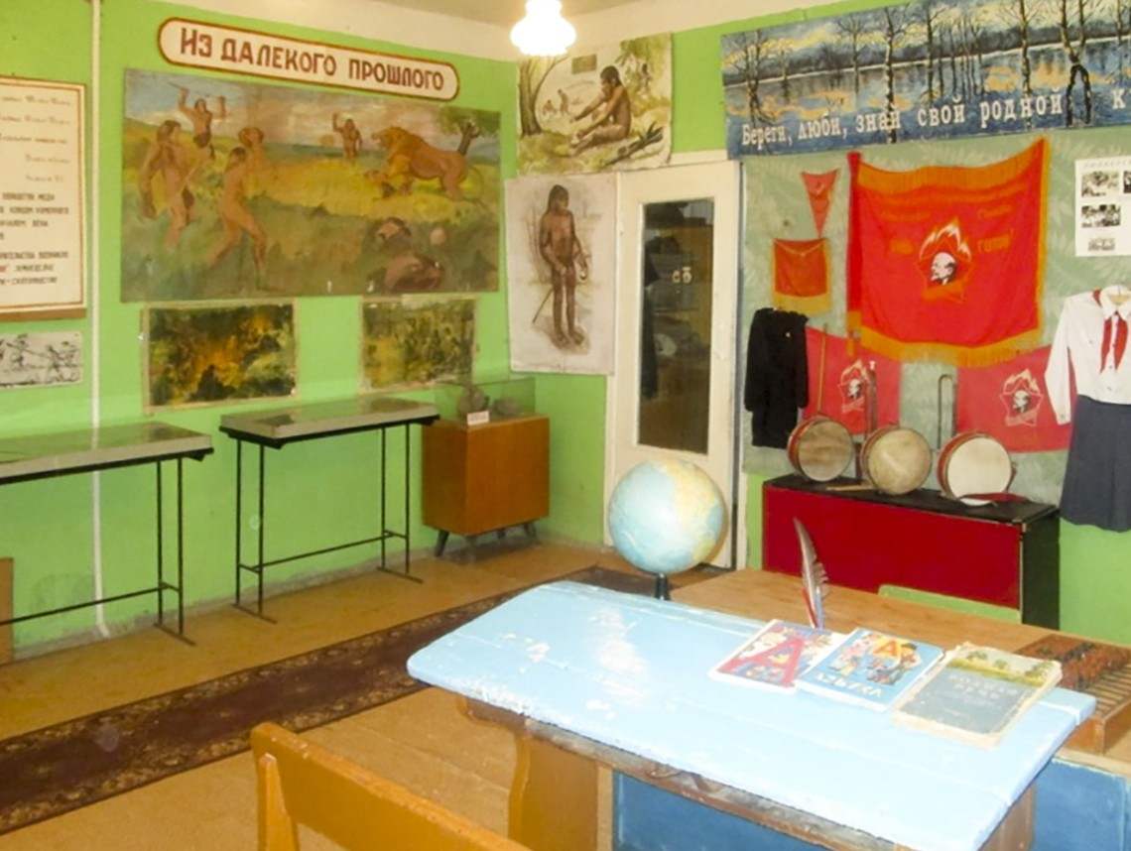
Staroivantsev Museum of Mordovian culture

Slide 6
The architectural complex of the Seraphim-Ponetaevsky monastery
The monastery was founded in 1864. The monastery’s architectural complex includes red brick buildings, a baptismal hall, several outbuildings, a section of the stone monastery wall and the royal well, consecrated with the blessing of Nicholas II in 1914.
The monastery was founded in 1864 by three novices who left the Seraphim-Diveevo monastery because of disagreements with the head of the community. After arranging the novices, other sisters of the Diveevsky monastery began to move to the estate, forming their monastery.
Serafimovo – Ponetaevsky monastery was famous for weaving, knitting and sewing, but the icon of the Sign of the Blessed Virgin Mary, written by her sister Claudia Voyloshnikova in 1879, brought her special fame.

Slide 7
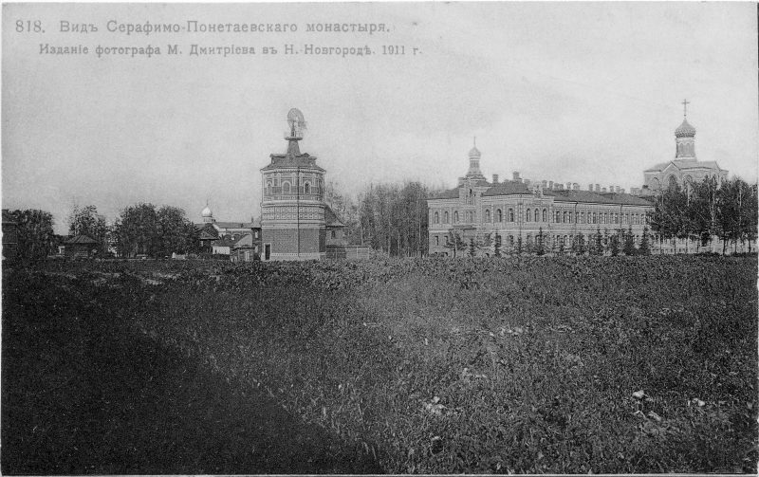
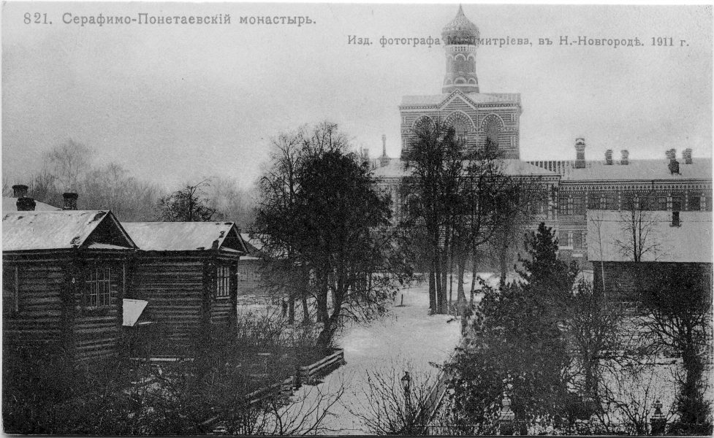
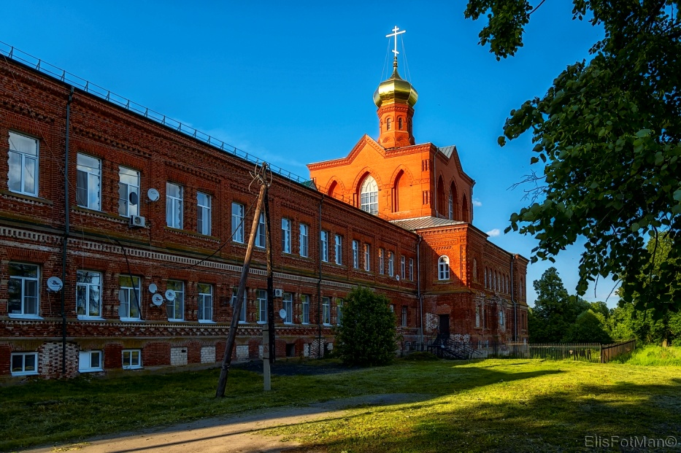
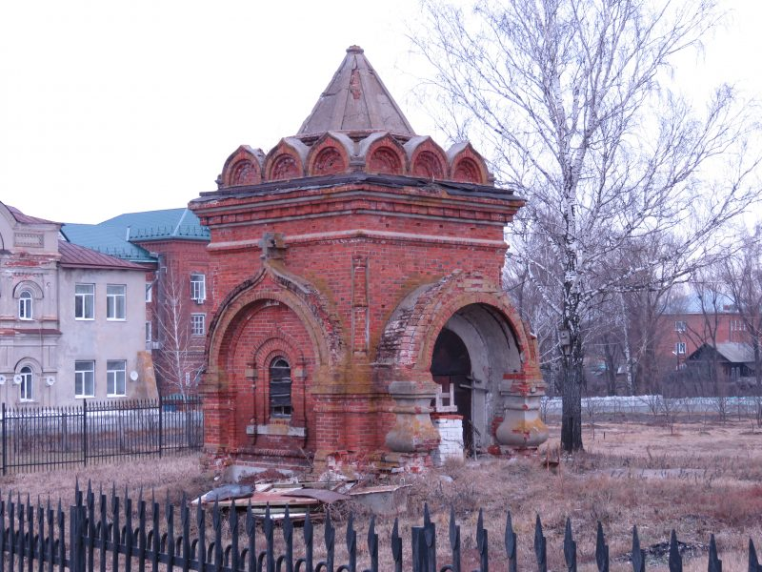
The architectural complex of the Seraphim-Ponetaevsky monastery

Slide 8
Church of St. John the Baptist in the village of Hirino
Despite the fact that many villages in the Shatkovsky district have their own shrines, many believers prefer the church in Khirino. They are attracted by the temple’s architecture unusual for rural areas, and the special atmosphere of miracle and unity that has been established here since the moment the temple was lifted up from ruins by the whole world. Then everyone tried to make a feasible contribution: the inhabitants helped to clear the nave before restoration, washed everything after the completion of work, planted flowers and ennobled the surrounding area.
A particle of relics brought by Igor Ashurbeyli to Russia from the Vatican.

Slide 9
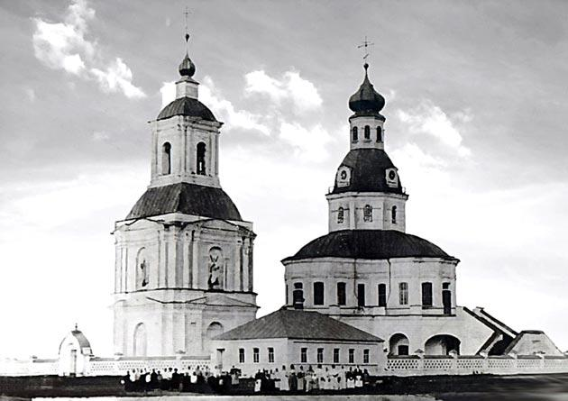
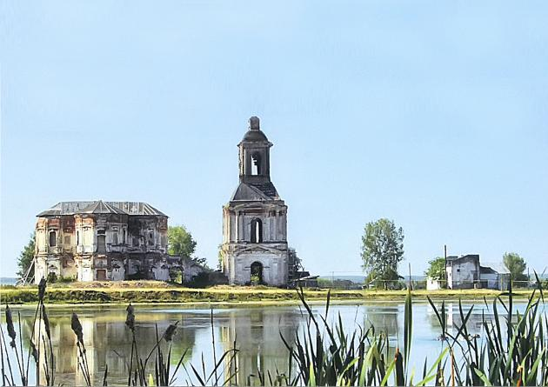
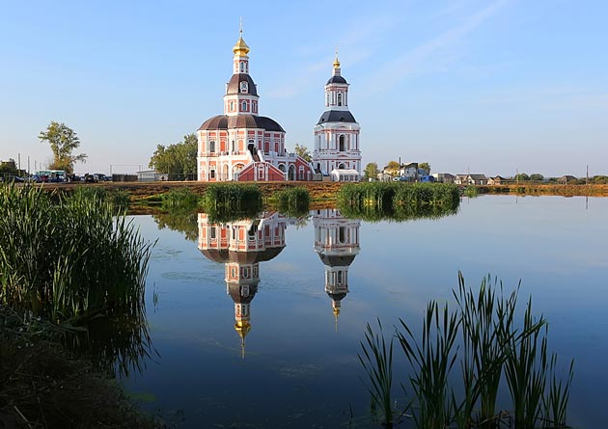
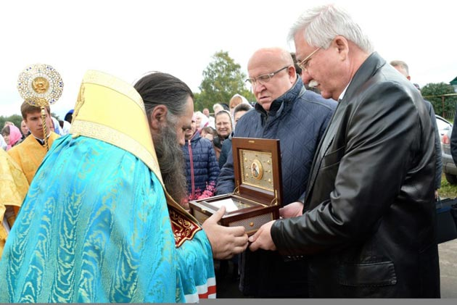
Church of St. John the Baptist in the village of Hirino
19th century
20th century
21st century

Slide 10
The memorial complex "Dedicated to Tanya Savicheva and the Children of War"
The memorial complex "Dedicated to Tanya Savicheva and the Children of War" was opened on May 7, 2010 on the territory of the school r.p. Shatki, authors - sculptors T. Kholuev and A. Kholueva. The complex consists of 12 concrete arches, in them there are 12 relief stories from the lives of children of besieged Leningrad. In the center there is a monument to Tanya Savicheva herself - an 11-year-old girl who became famous thanks to her diary, where the death of all relatives in the Leningrad blockade was written. The memorial was opened at the expense of the residents of the village of Shatki, a monument to Tanya was made in full growth at the Foundry of Yekaterinburg.

Slide 11
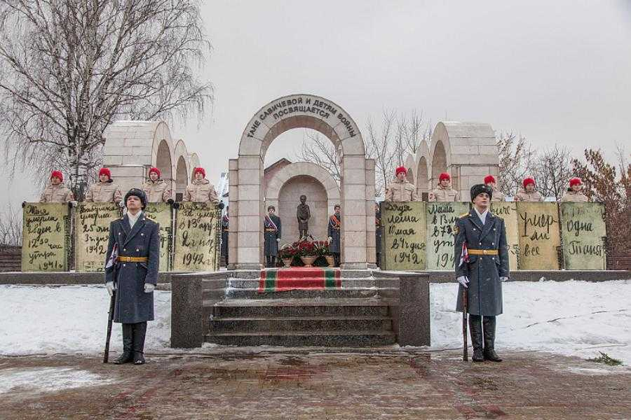
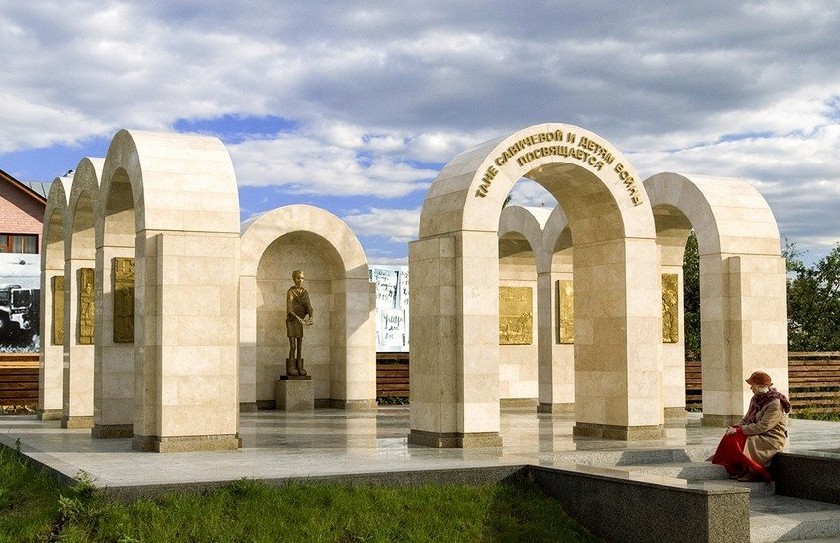
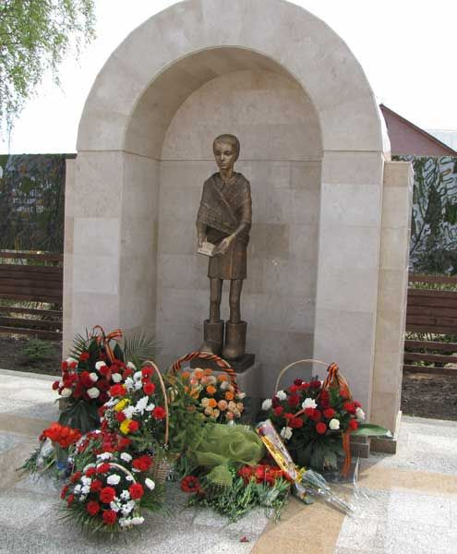
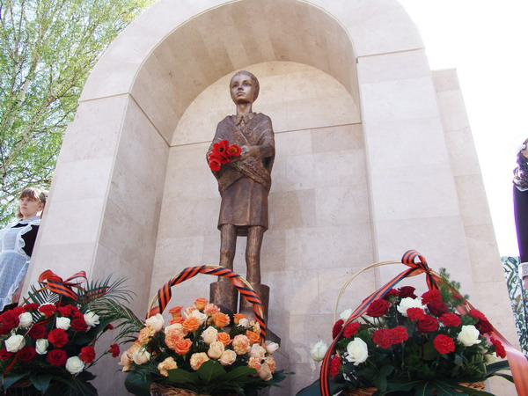
The memorial complex "Dedicated to Tanya Savicheva and the Children of War"

Slide 12
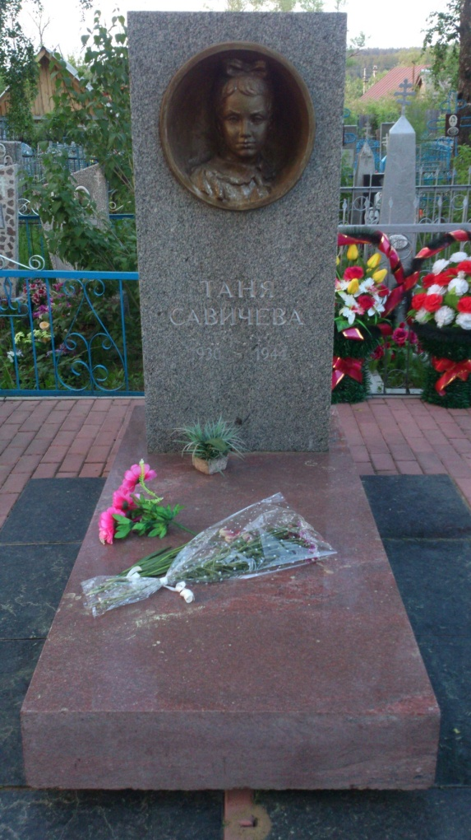
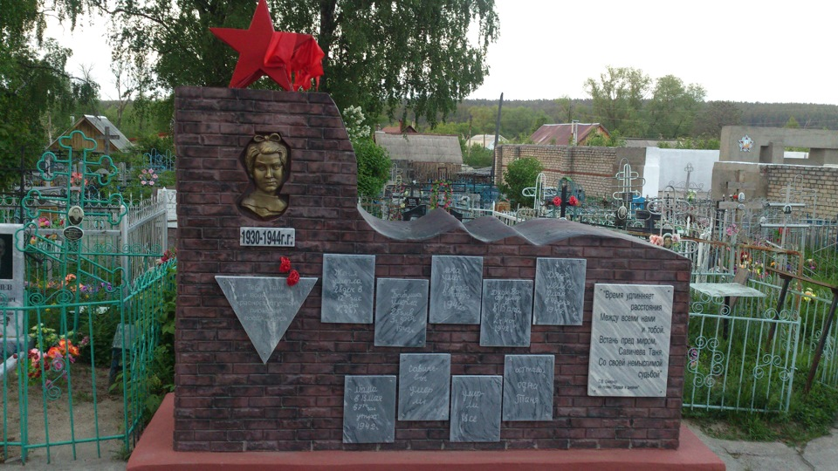
The grave of Tanya Savicheva
In Shatki a Leningrad schoolgirl Tanya Savicheva, a victim of the blockade, is buried. The pages of the girl’s diary became known throughout the world. In memory of the heroes of the Great Patriotic War and the children who died in its days, a memorial was erected in Shatki next to the old cemetery. There is the grave of Tanya.

Slide 13
The village of Arkhangelsk - source "Boiling Key"
Rest in the country is a great way to restore your physical and mental strength at any time of the year. Clean ecology, relaxed atmosphere, smooth and measured lifestyle. This resort will appeal to both adults and children.
Ad vantages of the Country Complex "Boiling Key":
• camping;
• integrated nutrition on schedule;
• treatment;
• three categories of baths.
Here every vacationer will be able to find something to his liking.

Slide 14
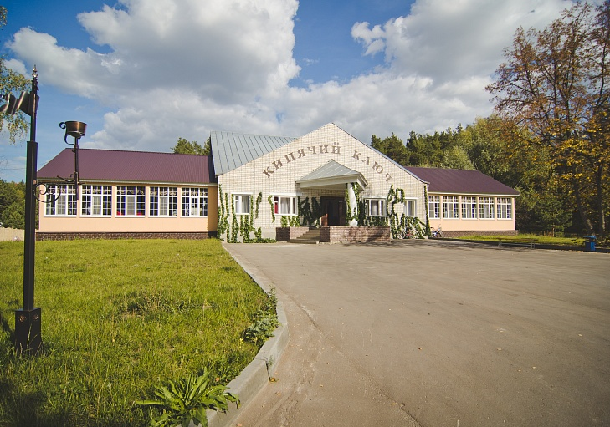
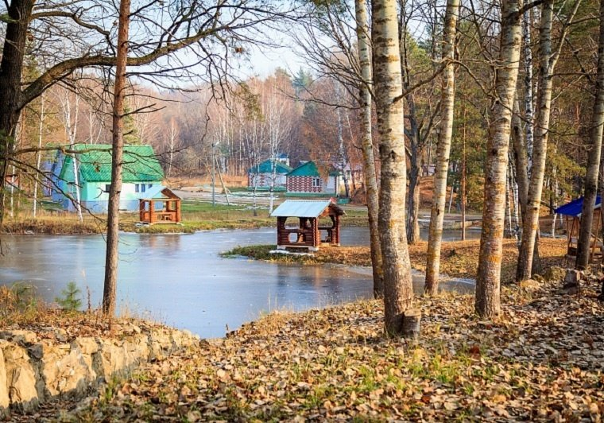
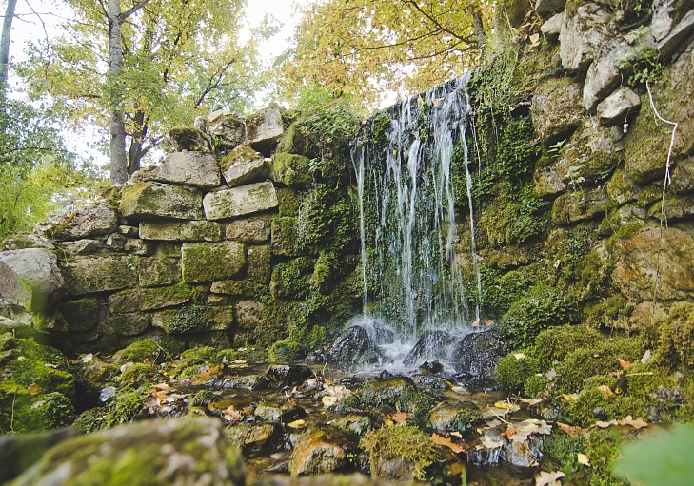
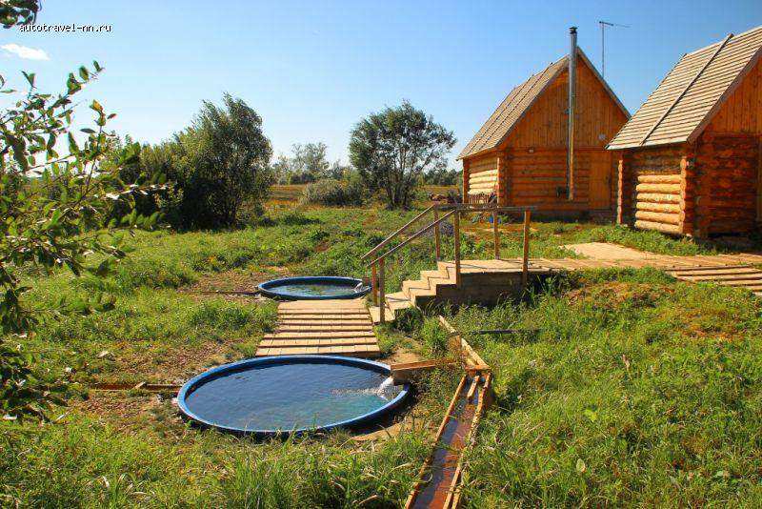
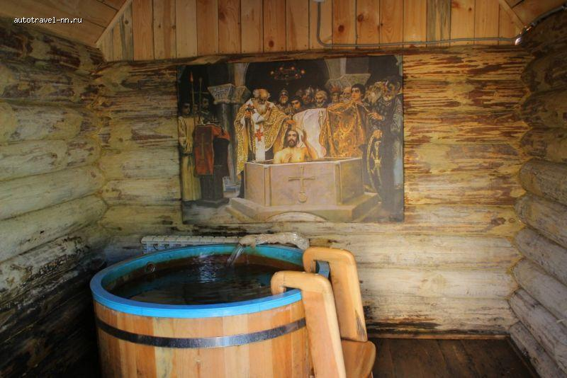
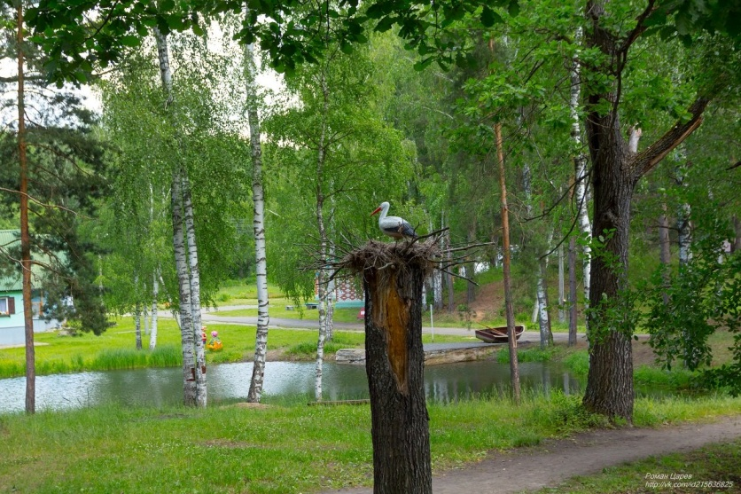
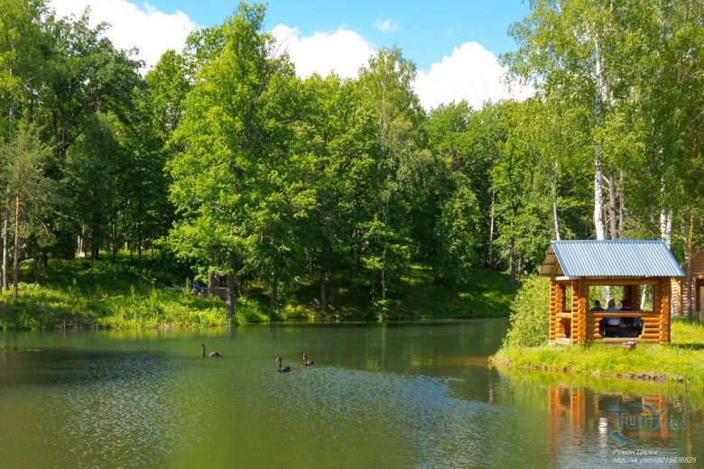
The village of Arkhangelsk - source "Boiling Key"

Slide 15
Welcome to the Shatkovsky district!

