Slide 1
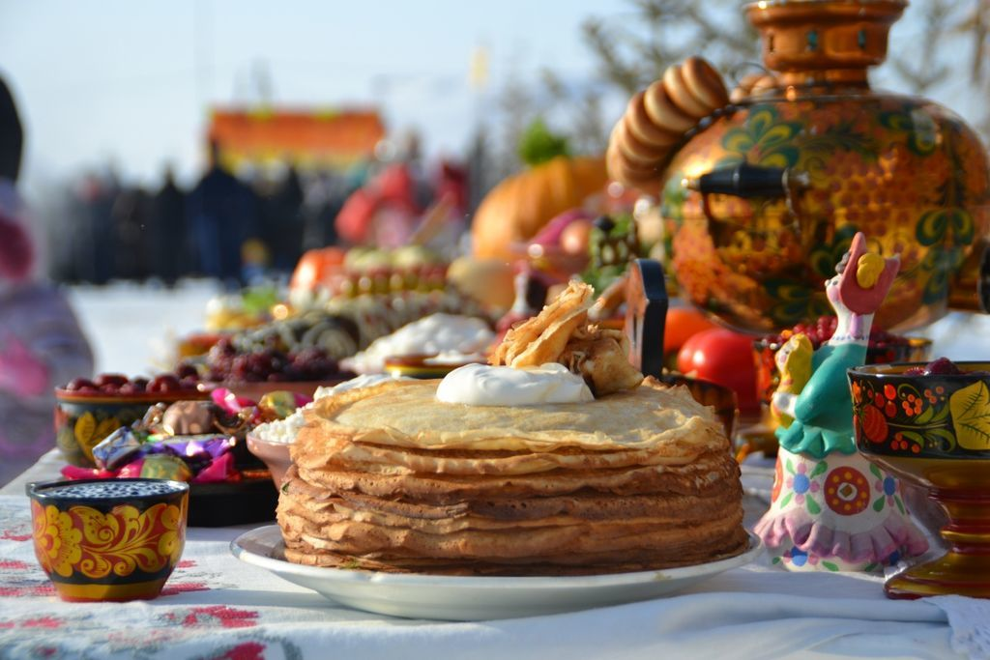
Презентация к уроку английского языка по теме: «Праздники» для 5 класса

Slide 2
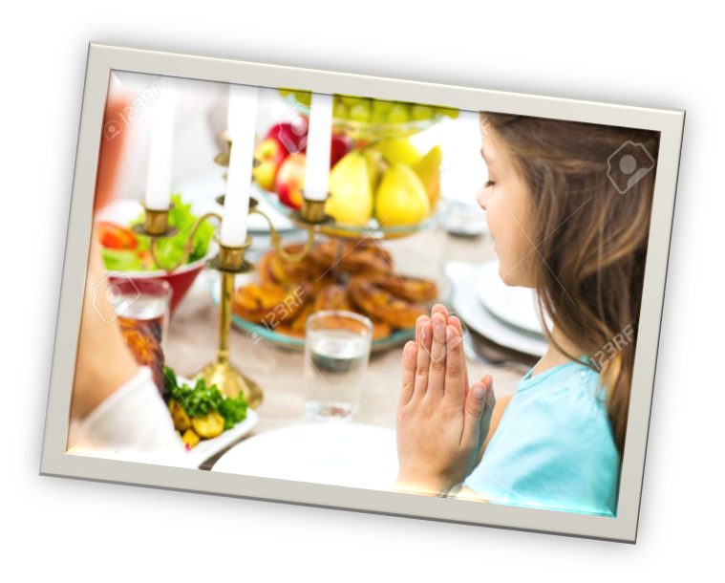
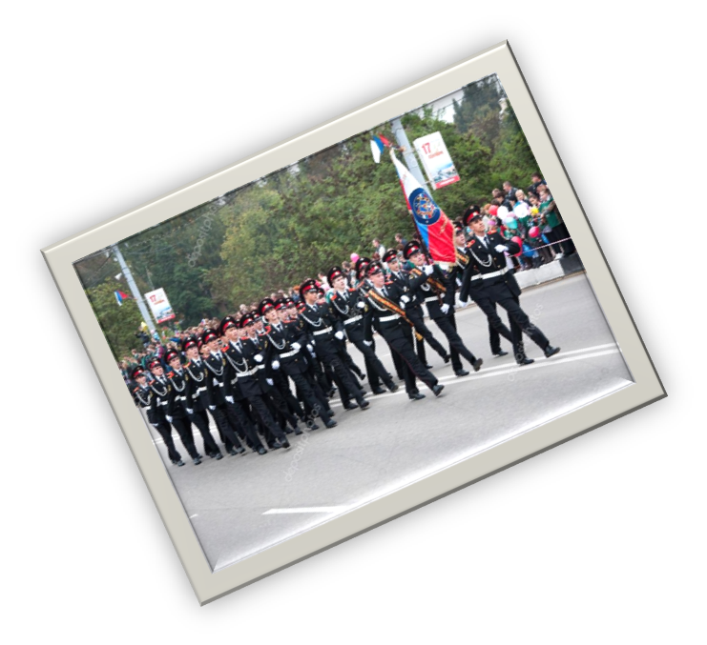
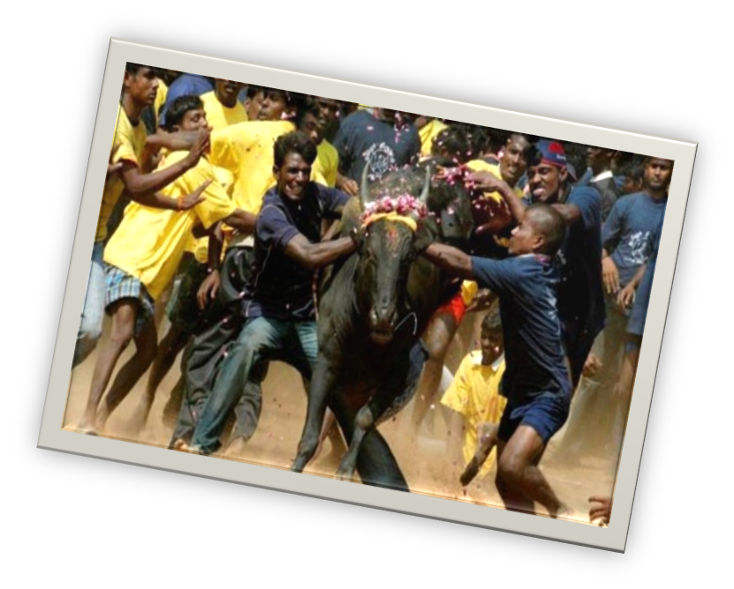
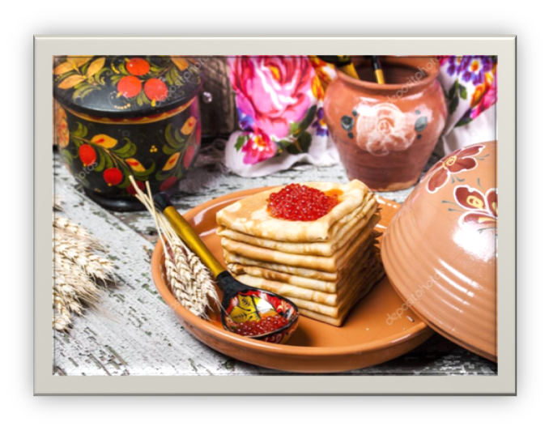
Selebrations

Slide 3
Thanksgiving

Slide 4
The Banana festival

Slide 5
Chuseok

Slide 6
The Hindu harvest festival

Slide 7
What do people do on…
1) Thanksgiving?
2) Victory Day?
3) Chuseok?
4) Hindu festival?
5) Banana festival?
6) Christmas?
7) New Year’s Day?
8) Halloween?
dress up, have street parades, set off fireworks, decorate the house, light bonfires, cook special food, have a family dinner, exchange gifts

Slide 8
Match the countries and the selebrations
1) the USA and Canada a) Victory Day
2) the Philippines b) Chuseok
3) India c) Thanksgiving
4) Russia d) Hindu festival
5) Korea e) Banana festival

Slide 9
What are they doing?

Slide 14
Complete the words to form collacations
1) exchange… bonfires
2) have… special food
3) cook… street parades
4) decorate… up
5) light… gifts
6) dress… the house

Slide 15
Describe the picture

Slide 16
Thank you for your attention!

